Slide 1

Type hinting for interfaces
By Min Thet Naing

Slide 2
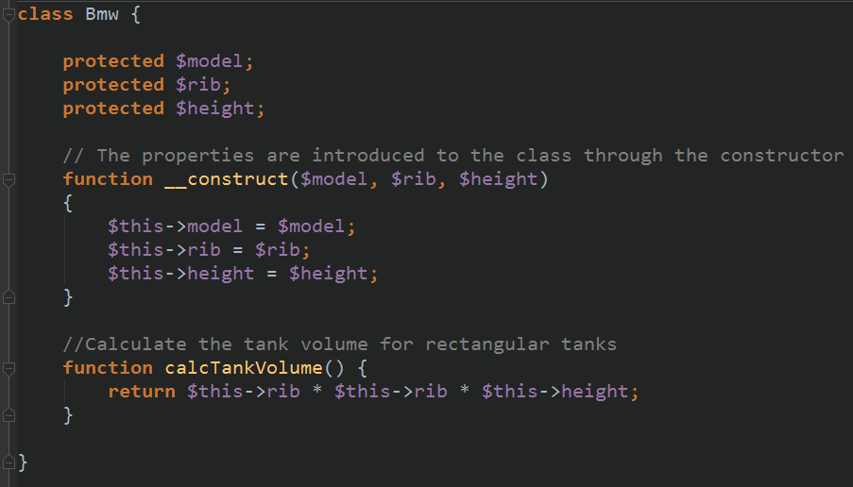
By Min Thet Naing

Slide 3
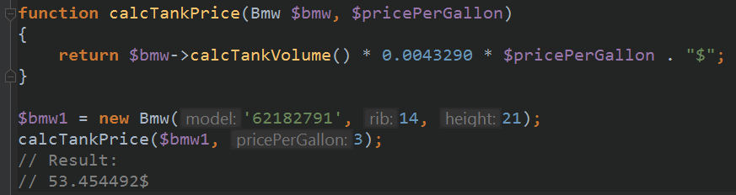
By Min Thet Naing

Slide 4
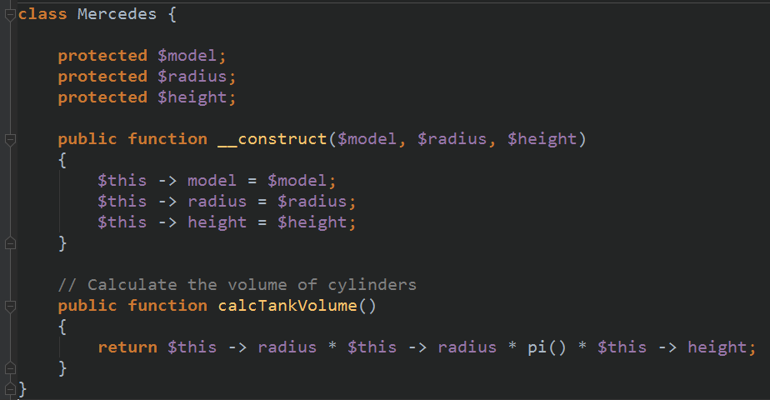
Manager decide to introduce to a brand new Mercedes
By Min Thet Naing

Slide 5
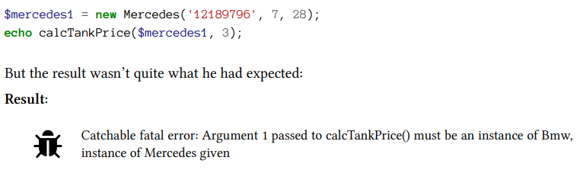
By Min Thet Naing

Slide 6
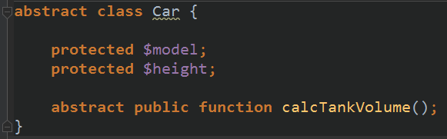
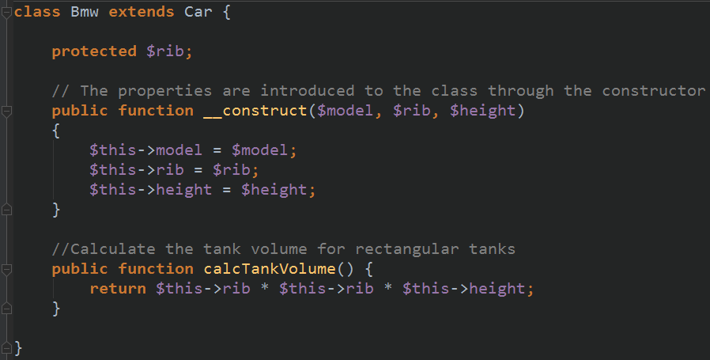
By Min Thet Naing

Slide 7
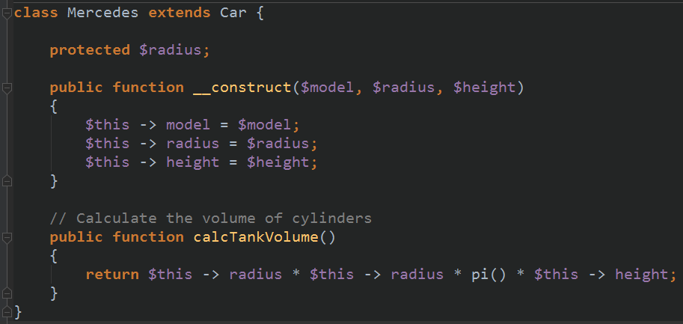
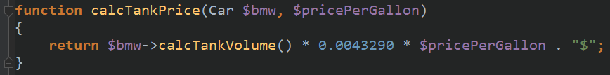
By Min Thet Naing

Slide 8
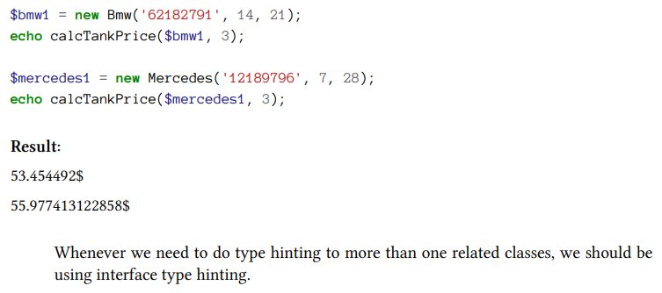
By Min Thet Naing

